Slide 1

Data 445 – Final Assignment Presentation Abid Khan

Slide 2
1 – Business Understanding –High Level
Notes:
For the High Level Business Understanding focus on the Case Study supplied.

Slide 3
Case Study
Name of the case study
Link:
https://businesscasestudies.co.uk/virgin-trains/

Slide 4
Introduction
This case study focuses on Virgin Trains, a brand name under Virgin Rail Group which is jointly owned by Virgin Management and Stage coach Group Plc.
Virgin trains is the result of two franchises; Wet Coast and Cross Country awarded to Virgin Rail Group by the British Government in the bid to separate infrastructure from operations of their rail services by franchising their passenger services and selling off freight operations.
This study focuses on Virgin Trains experience over the years, how far they've been able to achieve their visions and what can be done to improve these visions anchored on safety, consistency, reliability and profitability.

Slide 5
5W 1H Analysis 1 – Who
# | Question | Answer
Q1.1 | Who was involved? | Virgin trains British Rail Commuters Other TOCs ROSCOs Airlines
Q1.2 | Who was affected negatively? | Airlines Other TOCs
Q1.3 | Who has benefited from Virgins success? | Commuters Government Virgin Trains ROSCOs
Notes:
The questions on this slide are sourced from this article:
https://premium.wpmudev.org/blog/a-simple-sure-fire-way-to-create-great-content-the-5-w-the-h/
Who is involved?
Who is affected?
Who will benefit?
Who will be harmed?

Slide 6
5W 1H Analysis 2 – What
# | Question | Answer
Q2.1 | What is the topic narrowed down in a simple phrase/sentence? | Virgin Trains was franchised to provide rail services on the West Coast Main Line (WCML)
Q2.2 | What does the topic involve? (i.e. What are the different parts to it?) | How a private company successfully used their commercial skills and focus on staff and customers to achieve their goal statement: ‘To become the most safe, consistent, reliable and profitable of the train operating franchises in a climate that respects different views and people need not be afraid to be open and honest’
Q2.3 | What changed because of the topic? | Virgin Trains paved the way with many innovations in commuter rail to make it a more attractive alternative for commuters
Notes:
The questions on this slide are sourced from this article:
https://premium.wpmudev.org/blog/a-simple-sure-fire-way-to-create-great-content-the-5-w-the-h/
What is your topic narrowed down in a simple phrase/sentence?
What does your topic involve? (i.e. What are the different parts to it?)
What is it similar to / different from?
What might be affected/changed by your topic?

Slide 7
5W 1H Analysis 3 –When
# | Question | Answer
Q3.1 | When did this take place? | Starting in 1994 the British government started to allow franchising of railway operations. 1997 marked the beginning of Virgin Trains franchising and was scheduled for termination in 2012
Q3.2 | Does when this takes place affect the topic? | Yes this time period includes the 2008 recession which greatly impacted economies across the world
Notes:
The questions on this slide are sourced from this article:
https://premium.wpmudev.org/blog/a-simple-sure-fire-way-to-create-great-content-the-5-w-the-h/
When does this take place? When did this take place? When will it take place? When should this take place?
Does when this takes place affect the topic?

Slide 8
5W 1H Analysis 4 – Where
# | Question | Answer
Q4.1 | Where does this take place? | This takes place in the United Kingdom. Specifically the case is on the West Coast Main Line (WCML).
Q4.2 | Does it matter where it takes place? Is it affected by location? | The WCML is the busiest line in Britain so reputational as well as financially risks were considerable. Additionally since Virgin Trains was not in charge of infrastructure they had no control over infrastructure changes occurring on the line
Notes:
The questions on this slide are sourced from this article:
https://premium.wpmudev.org/blog/a-simple-sure-fire-way-to-create-great-content-the-5-w-the-h/
Where does this take place? (Where did it …. Where will it … Where should it ….?)
Does it matter where it takes place? Is it affected by location?

Slide 9
5W 1H Analysis 5 – Why
# | Question | Answer
Q5.1 | Why is this topic important? Why does it matter? | The WCML carries more than 40% of UK rail freight as well as other passenger services. This means that this line is integral to commuters and industry alike
Q5.2 | Why do certain things happen? (What are some causes and effects within the topic?) | These franchises were created by the government to make use of the expertise in the private sector of transportation. Companies like Virgin were able to bring new innovations to the table faster than a government likely could. It also takes strain off British Rail so they can focus solely on infrastructure on the rail lines
Notes:
The questions on this slide are sourced from this article:
https://premium.wpmudev.org/blog/a-simple-sure-fire-way-to-create-great-content-the-5-w-the-h/
Why is this topic important? Why does it matter?
Why do certain things happen? (What are some causes and effects within the topic?)

Slide 10
5W 1H Analysis 6 – How
# | Question | Answer
Q6.1 | How does this topic work? | Under franchising the government and private companies such as Virgin entered a regulatory relationship. The contractual obligations were detailed in the franchise agreements and other similar documents
Q6.2 | How are those involved affected? | Virgin Rail posted great profit margins The British government after subsidising the venture for years Virgin paid a began paying surplus back to the government in 2008 Commuters began using rail more for travelling between the northern and southern regions of the UK
Notes:
The questions on this slide are sourced from this article:
https://premium.wpmudev.org/blog/a-simple-sure-fire-way-to-create-great-content-the-5-w-the-h/
How does this topic work? How does it function? How does it do what it does?
How did it come to be?
How are those involved affected?

Slide 11
Problem Solving Process 1 – Exploring the mess
# | Question | Answer
Q1.1 | What did Virgin do? | Lured commuters away from airlines Increased the traffic on the WCML Introduced faster trains Introduced new amenities on the trains (WiFi, onboard shop, etc.)
Q1.2 | What were the stated and unstated goals? | Virgin Trains vision was :‘To become the most safe, consistent, reliable and profitable of the train operating franchises in a climate that respects different views and people need not be afraid to be open and honest’ Unstated goal: Increase the amount of commuters using rail as a method for travel in the United Kingdom
Notes:
This step is complete when we have produced a satisfactory description of the situation and when we have identified (but not necessarily gathered) the key facts and data.

Slide 12
Problem Solving Process 2 – Searching for information
# | Question | Answer
Q2.1 | What were the benefits to Virgin Trains? | Reducing wait times, travel times, and increasing customer satisfaction lead to greater profit than the average for most other rail franchises. Virgins profit margins were in the 4-13% range whereas typical margins were in the 3-4% range
Q2.2 | What measures did Virgin Trains use to assess effectiveness | Train speed and quantity Passenger Traffic Public permanence measure (PPM) (% trains less than 10 minutes late) Overall customer satisfaction
Q2.3 | What actions were available to Virgin? | Bringing new innovations and existing corporate culture from Virgins previous transportation ventures Introducing new trains to increase the speed of travel between origin and destination Adding new amenities to trains to increase customer satisfaction
Notes:
This step is complete when we have found and organized relevant information for the situation at hand and when we have made some initial hypotheses about the source of the problem and potential solutions.

Slide 13
Problem Solving Process 3 – Identifying possible problems
# | Question | Answer
Q3.1 | What are problems that Virgin may face in the future? | Difficulties in expansion Difficulties in maintaining market share from air travel Competition from other TOCs Maintenance of their customer satisfaction Stagnation in passenger traffic Not knowing where, how, and when they were successful and why
Q3.2 | Possible problem of focus | Not knowing where, how, and when they were successful and why
Q3.3 | What is the problem statement | Virgin trains needs to know where and when they made the most profit. This will allow further analysis to discern why exactly this was the case.
Notes:
This step is complete when we have produced a working problem statement.

Slide 14
Problem Solving Process 4 – Searching for a solution
# | Question | Answer
Q4.1 | What decisions are open to us? | We only have a few datasets to work with so we will be only making small generalizations. This will be exploratory for further analysis
Q4.2 | What are the outcomes of interest? | Profit Location Time
Q4.3 | What solution have we chosen to implement | We have chosen to analyze profits made by stations along the train line over a period of time. This will show us where and when we can look for areas of interest for further study and insights.
Notes:
This step is complete when we have produced a list of potential solutions and perhaps a list of advantages and disadvantages for each one.

Slide 15
Problem Solving Process 5 – Evaluating solution
# | Question | Answer
Q5.1 | How did the solution impact each of the criteria? | Analyzing station data allows to look at all of the criteria simultaneously Stations provide a location Each station has expenses and revenue to examine profit Each station can be measured over time
Q5.2 | What factors within Virgins control could have altered the criteria? | Providing more or less trips to certain stations could have altered this data Providing certain promotions for certain locations could have altered this data
Q5.3 | What factors outside their control could have altered the criteria? | Changes to the surrounding location of the stations and the commuter pull they bring would alter the data Changes made by British Rail to the infrastructure in and around stations would alter the data Changes to the economic and social climates could change how and when people commute which would alter the data. (Pandemic)
Notes:
This step is complete when we have produced a recommended course of action, along with justification that supports it.

Slide 16
Problem Solving Process 6 – Implementing a solution
# | Question | Answer
Q6.1 | What barriers to successful implementation could we face? | Data integrity and accuracy was the only barrier to implementation
Q6.2 | Where was there support and motivation, or resistance and conflict? | Support would come from corporate because we are implementing a low cost solution to find out where to spend more resources searching for other answers and insights We could not think of any place resistance would come from
Q6.3 | Were there resources available for successful implementation? | Yes the data was already gathered in an OLTP database
Notes:
This step is complete when we have produced an implementation plan and executed enough of it to begin evaluating how well it is succeeding.

Slide 17
2 – Data Understanding – High Level

Slide 18
Data Modeling – Conceptual Model
British Rail
(Government owned)
Other TOCs
Positive Financial outcome
Franchiser
Virgin Rail Group
(West Coast, Cross Country)
1997-2012
ROSCOs
Increased Service and Performance
Faster travel time
New Train Routes
Passenger charter and complaint
Rights of customers were mentioned on tickets
Advancement and
Development of facilities for passengers journey
Empowerment of staff
Training academy
Career development
Competitive Fares and ticketing
Modernize ticket system

Slide 19
Data Dictionary
Page 1
No | Topic | Definition
1 | Virgin Trains | Train operating company in the United Kingdom owned by Virgin Rail Group
2 | British Rail | state-owned company that operated most of the overground rail transport in Great Britain from 1948 to 1997
3 | Franchise agreement | legally binding contract. It sets out the rules of the franchising relationship that both the franchisor and franchisee have agreed to
4 | Passengers charter | Sets out what a passenger, need to know about your rights and responsibilities when travelling in Virgin trains
5 | West Coast Main Line (WCML) | Railway corridors in the United Kingdom, connecting the major cities on the west side of the UK from London all the way to Glasgow
6 | Freight operations | The system of transporting goods, that are carried from one place to another by virgin train
7 | Intercity franchise | Railway franchise in the United Kingdom for passenger trains on the West Coast Main Line
8 | Train operating company (TOC) | Business operating passenger trains on the railway system of Great Britain
9 | (ROSCO) Rolling stock leasing company | Company owns and maintains railway engines and carriages which are leased to train operating companies who operate the trains
10 | Virgin atlantic airline | English airline with its head office in Crawley, England
11 | Self service ticketing vending machine | Equipment that allows everyone to buy, quickly and easily tickets in train stations
12 | National rail conditions of carriage | A ticket which entitles you to travel on the Underground and/or Docklands Light of train station
13 | thetrainline.com | International digital rail and coach technology platform with headquarters in
14 | Tilting electric train | Train that has a mechanism enabling increased speed on regular rail tracks
15 | Tilting diesel train | Train operates on diesel that has a mechanism enabling increased speed on regular rail tracks

Slide 20
Data Dictionary
Page 2
No | Topic | Definition
16 | Private railway operating company | Railway owned and operated by private sector
17 | Commercial Management | Identification and development of business opportunities and the profitable management of projects and contracts
18 | Infrastructure investment | Fixed assets used for the operation of a railway including its permanent way and plant used for signalling or exclusively for supplying electricity for operational purposes to the railway
19 | Public sector | The part of an economy that is controlled by the government
20 | Private sector | The part of an economy that is not under controlled of government
21 | British bus operators | Bus companies in the UK
22 | Intercity services | That run services that connect cities over longer distances than commuter or regional trains
23 | Cross Country agreement | The Trade and Cooperation Agreement establishes a new framework for law enforcement and judicial cooperation
24 | Department for Transport | Department responsible for the transport network across the country
25 | Manufacturer-provided maintenance | Manufacturing facilities can prevent, diagnose, and solve complex asset breakdowns
26 | Public Performance Measure (PPM) | Measure of the punctuality and reliability of passenger trains in Britain
27 | Contractual relationship | Relationship between Virgin Trains and its customers
28 | Cross Country | Rail InterCity CrossCountry passenger franchise
29 | Management fee | Periodic payment that is paid by an investment fund to the fund's investment adviser for investment

Slide 21
1 Business Understanding – Low Level

Slide 22
Business Questions
Question 1) What was the average yearly profit of all stations combined between 2004-2013 and what will average yearly profit be for the next 5 years
Question 2) What was the most profitable year for each station between 2004-2013?

Slide 23
2 Data Understanding – Low Level

Slide 24
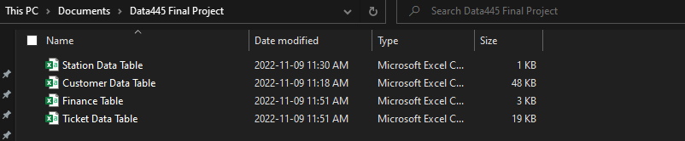
Data Set(s)
Root:C:\Users\benmi\OneDrive\Documents\Data445 Final Project
Image:

Slide 25
4– SCD Changes

Slide 26
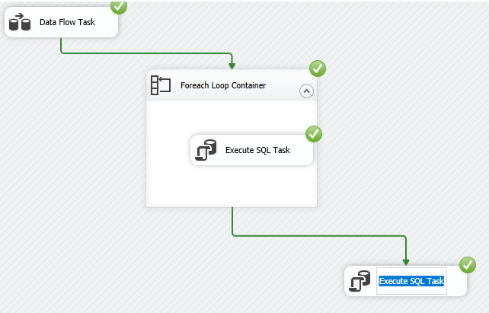
SCD Changes- Visual Studios
We had issues with SCD changes
After taking some time to look at the errors in the outputs and attempting to do it manually in SQL we found that the problem was SQL did not want us to duplicate business keys in a table.
We could not find a way to get around this so we simply temporarily removed the business key status from the table in question.

Slide 27
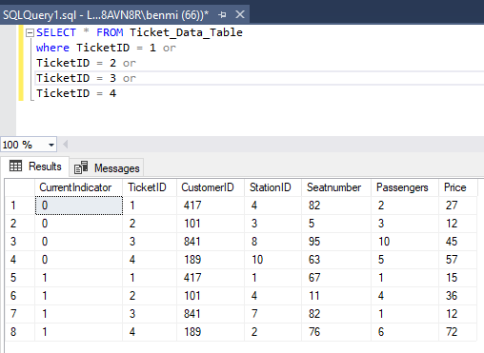
SQL SCD- 4 Changes
We were able to make the changes in visual studios and these are the results

Slide 28
5– Visual Studio Analysis

Slide 29
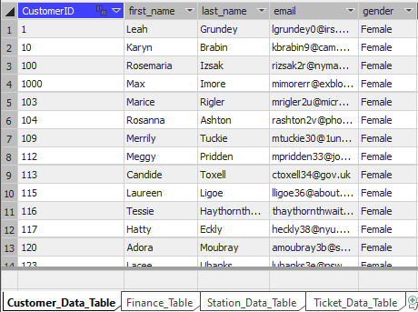
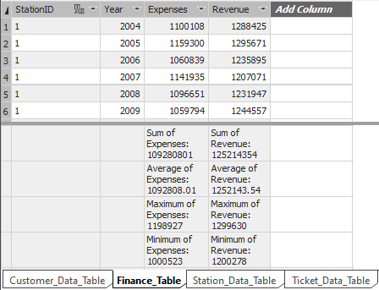
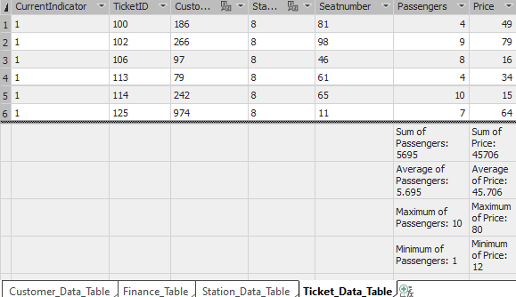
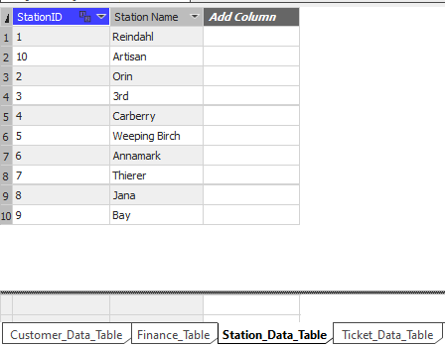
Visualization - Dashboard
Notes:
Provide a screen shot of the visualization built in Power BI or Tableau.

Slide 30
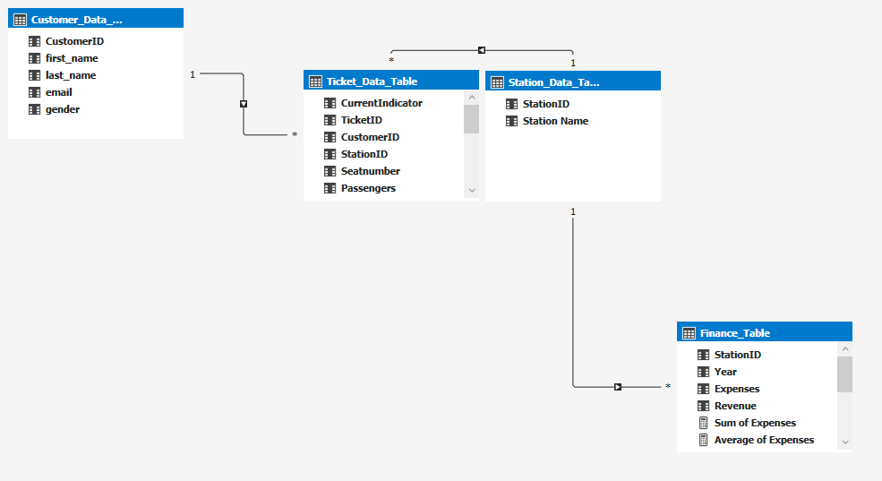
Visualization – Diagram
Notes:
Provide a screen shot of the visualization built in Power BI or Tableau.

Slide 31
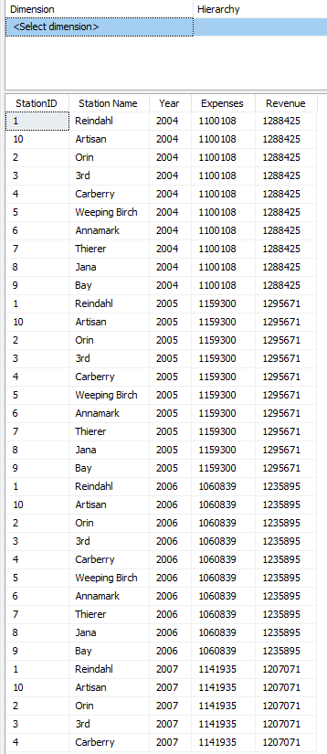
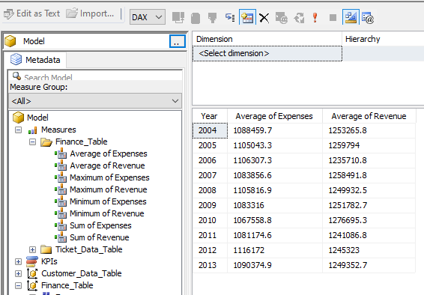
Visualization – SQL Browser
Notes:
Provide a screen shot of the visualization built in Power BI or Tableau.
Top 5 Cities with the highest profit.

Slide 32
7– Excel Pivot Table Solution

Slide 33
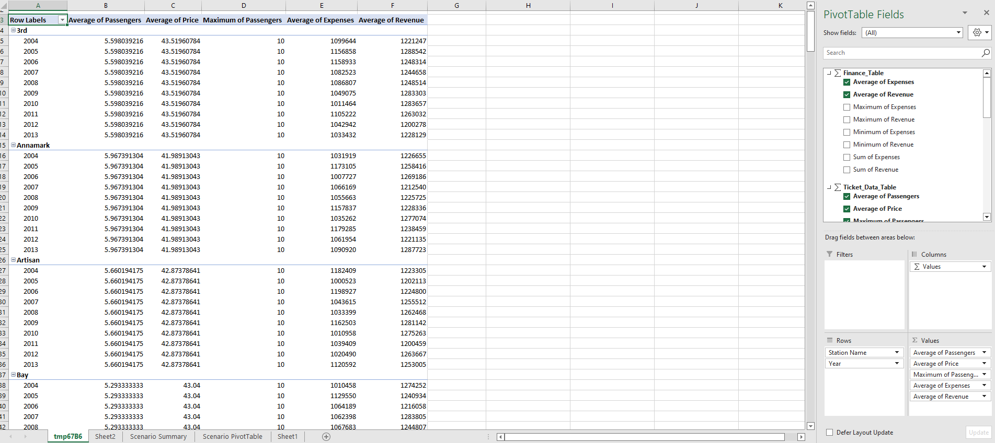
Pivot table

Slide 34
8– Forecast Analysis and Scenario Manager

Slide 35
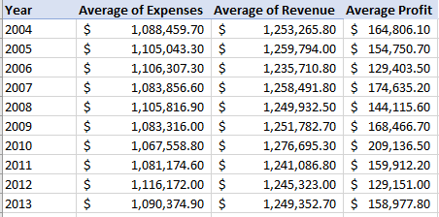
Data table
Derived a new column for profit

Slide 36
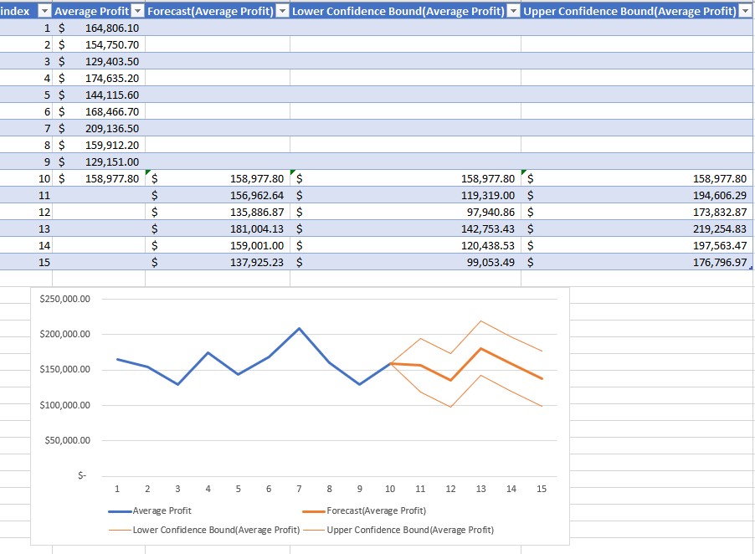
Forecast
This forecast shows the next 5 years of average profit from all stations

Slide 37
Scenario Analysis
Virgin has some ideas to improve customer satisfaction. They are not sure if they will make more revenue but know how much they will cost.
Our Scenario Analysis depicts how much profit we could still make by increasing our Expenses by 5%, 10% 15% and 20% given the current revenue. This will help us determine our profit margin and know when increase in expenses could lead to loss in profits.

Slide 38
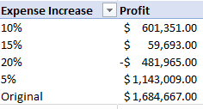
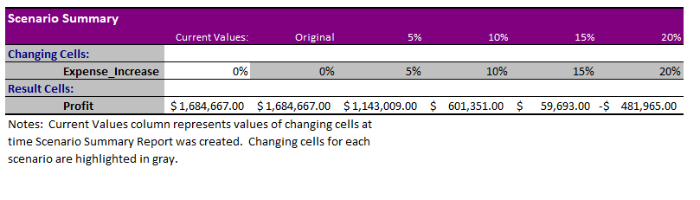
Scenario Summary / Pivot table
From our Scenario Analysis, we can conclude that an increase in expenses of up to 20% will lead to a loss in profits. Therefore, we might consider limiting any increase in expenses to a maximum of 15%.

Slide 39
9 –Visualization

Slide 40
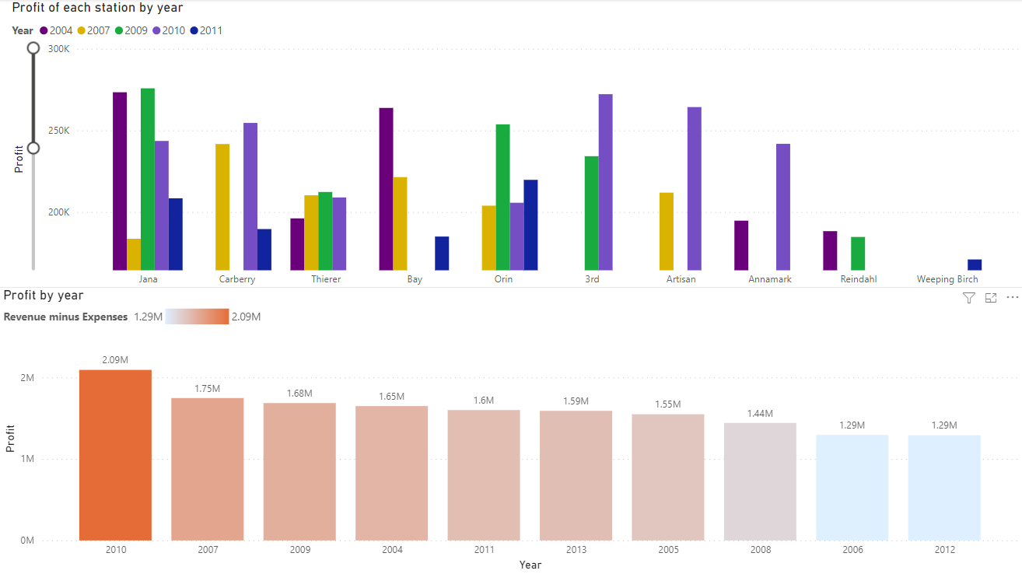

Slide 41
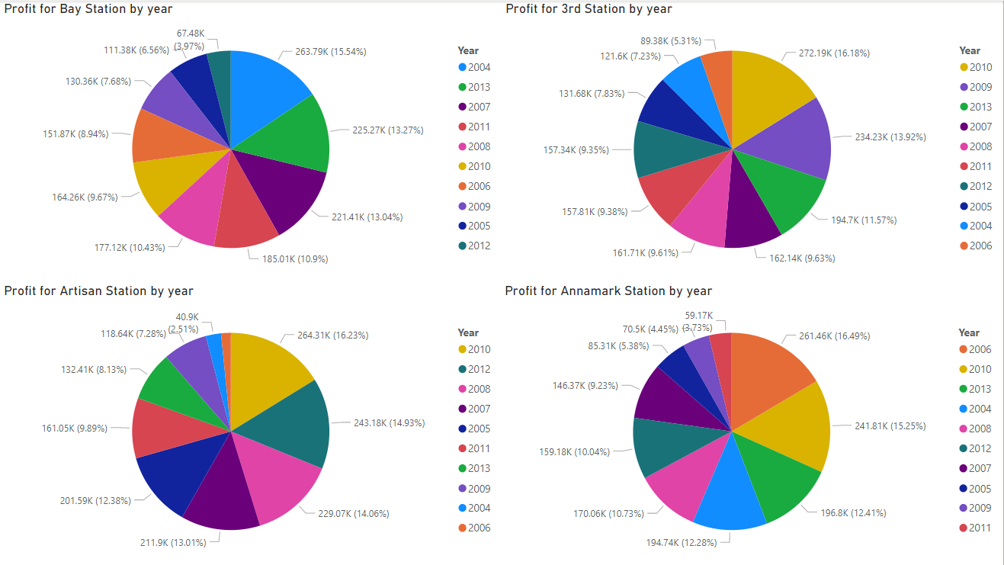
Power BI Visuals

Slide 42
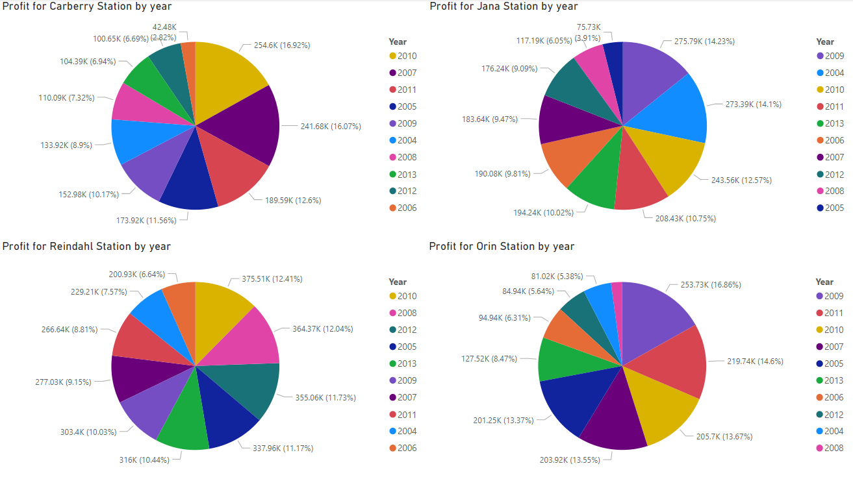

Slide 43
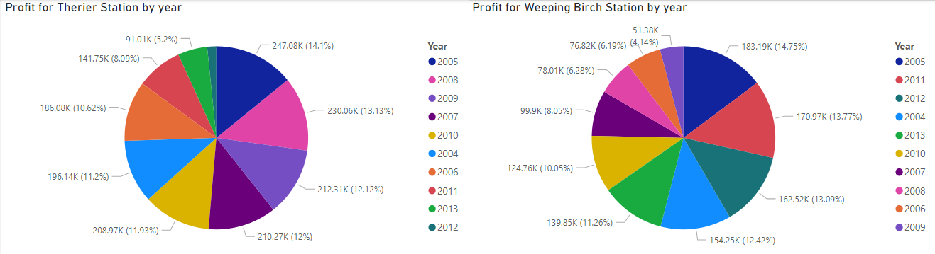
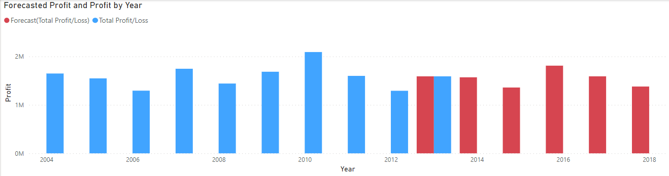

Slide 44
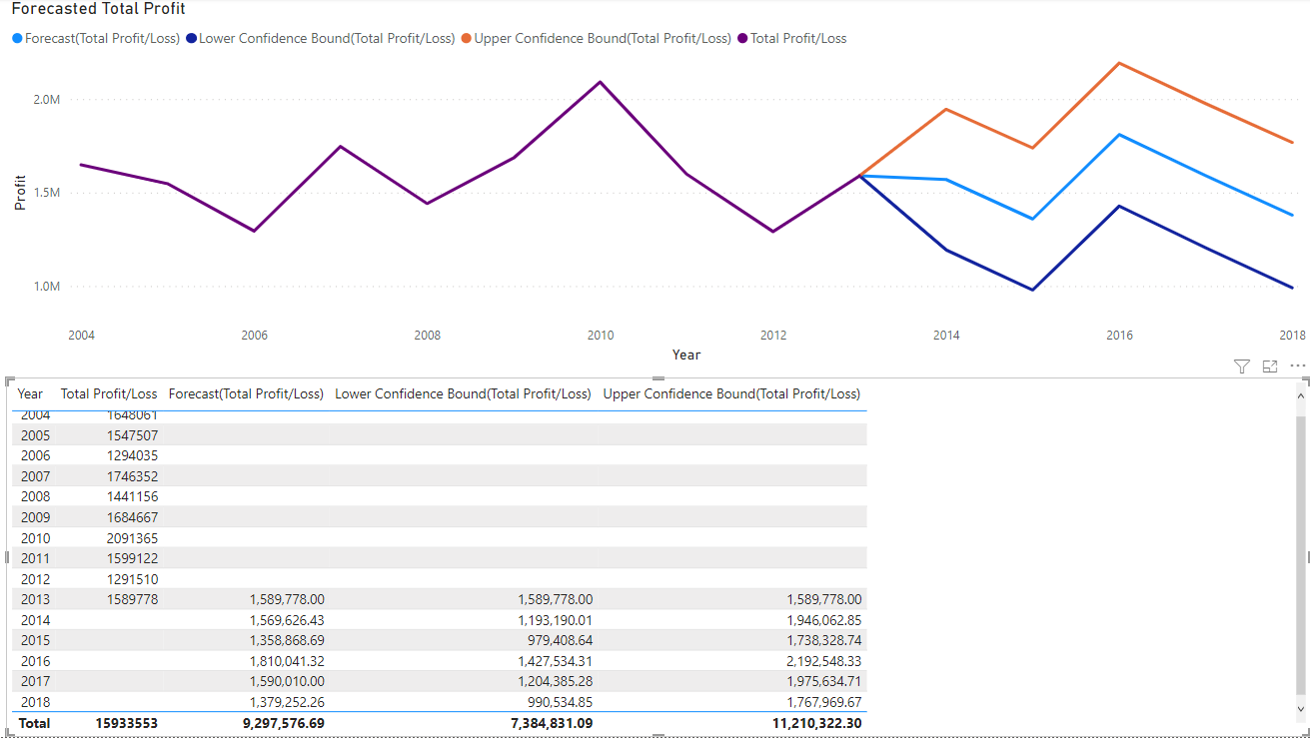

Slide 45
5 – Evaluation

Slide 46
Conclusion – Answer to Question 1
Question #1: What was the average yearly profit of all stations combined between 2004-2013 and what will average yearly profit be for the next 5 years
Answer: The average yearly profits for all stations combined are;
2004 = 1.65M 2009 = 1.68M
2005 = 1.55M 2010 = 2.09M
2006 = 1.29M 2011 = 1.6M
2007 = 1.75M 2012 = 1.29M
2008 = 1.44M 2013 = 1.59M
2014 = 1.19M
2015 = 979K
2016 = 1.43M
2017 = 1.2M
2018 = 991K Forecasted
Notes:
The answer to the question from Slide 21 needs to be supported by the data visualized in the previous steps.

Slide 47
Conclusion – Answer to Question 2
Question #2: What was the most profitable year for each station between 2004-2013?
Answer:
Bay station: 2004
Artisan station: 2010
3rd station: 2010
Annamark station: 2006
Carberry station: 2010
Orin station: 2009
Jana station: 2009
Reindahl station: 2010
Therier station: 2005
Weeping Birch station: 2005
Notes:
The answer to the question from Slide 21 needs to be supported by the data visualized in the previous steps.

